Slide 1
AIML CA2: Part A Time Series
Name: Glenn Wu
Admin No.: 2214395
Class: DAAA/FT/2A/01

Slide 2
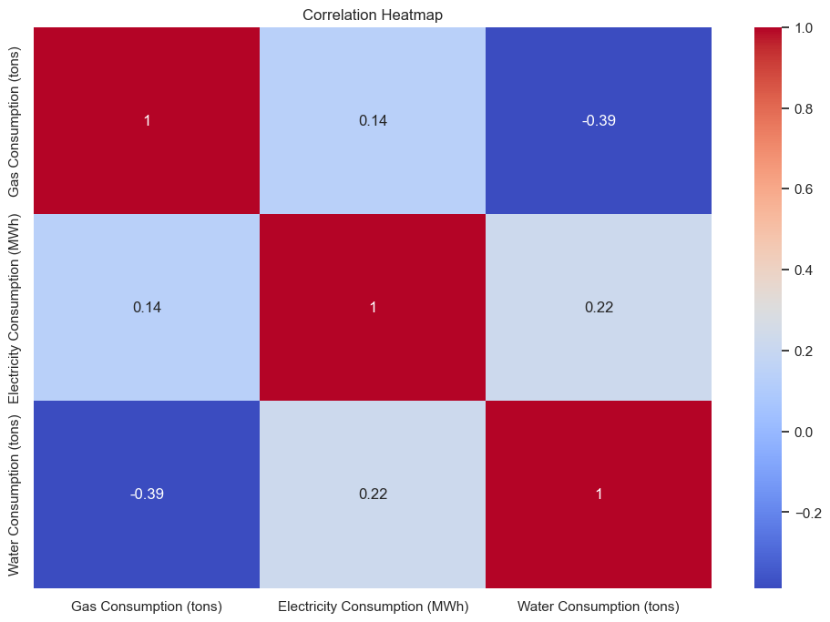
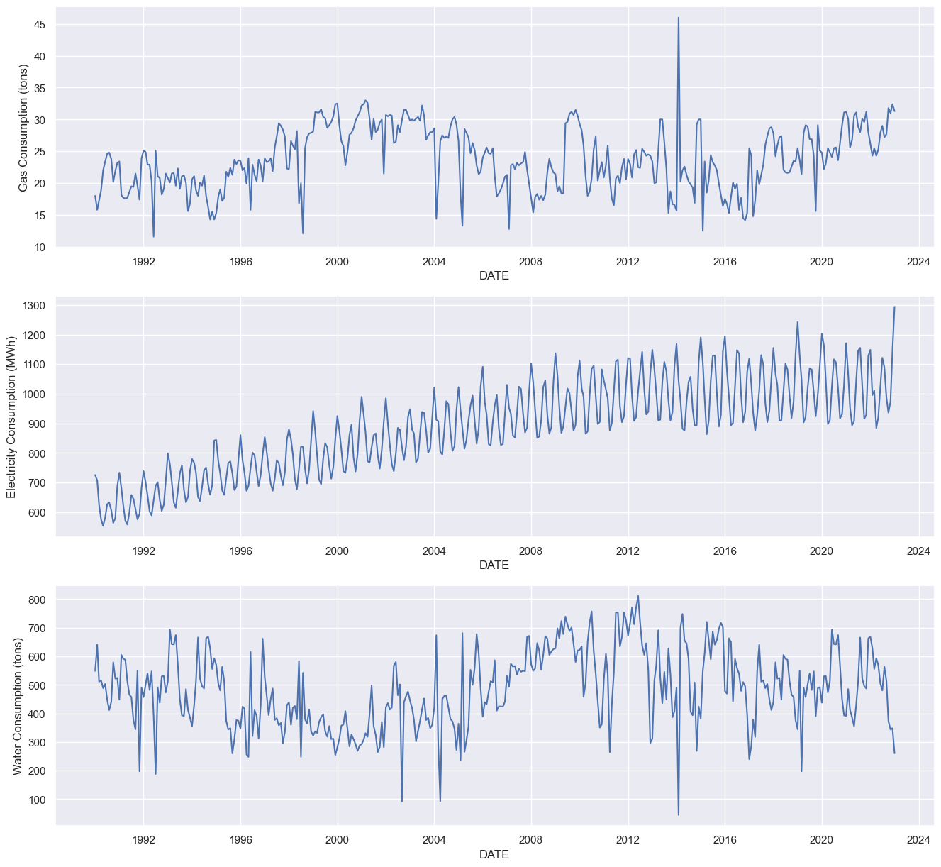
Data Exploration
Clear seasonal component for Electricity Consumption
None of the time series look stationary
Moderate negative linear relationship between Gas and Water consumption

Slide 3
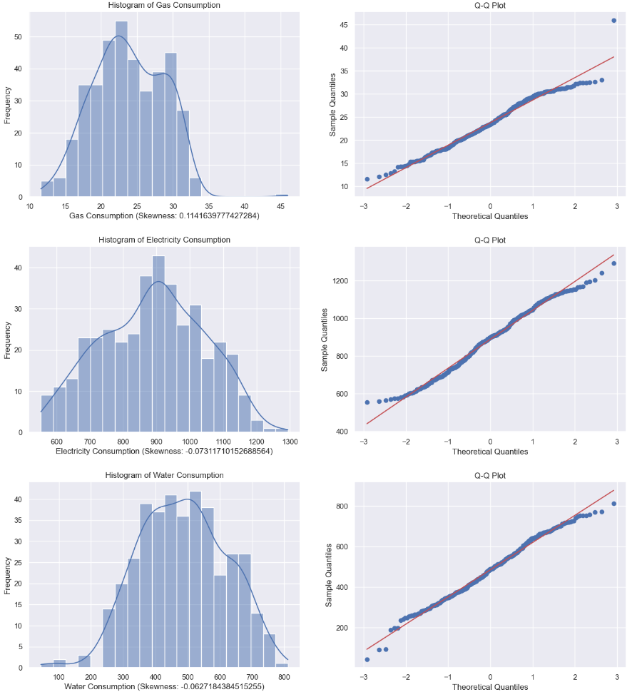
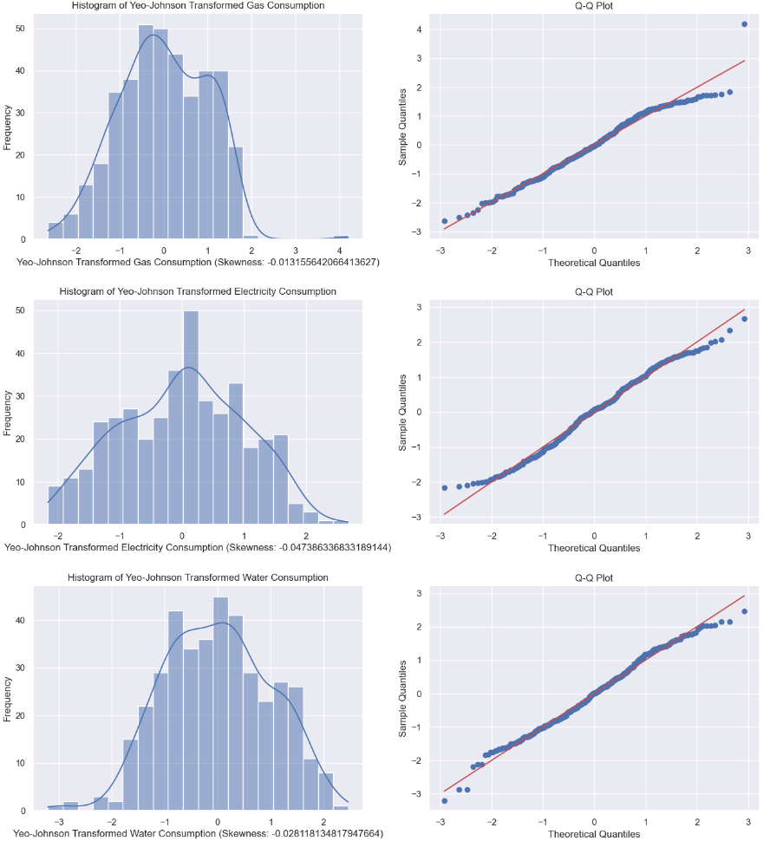
Data Exploration
Reduce skewness of the time series using Yeo-Johnson Transformation. Data has very low skew to begin with.

Slide 4
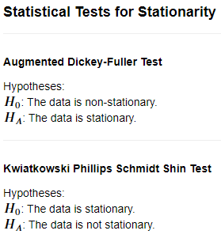
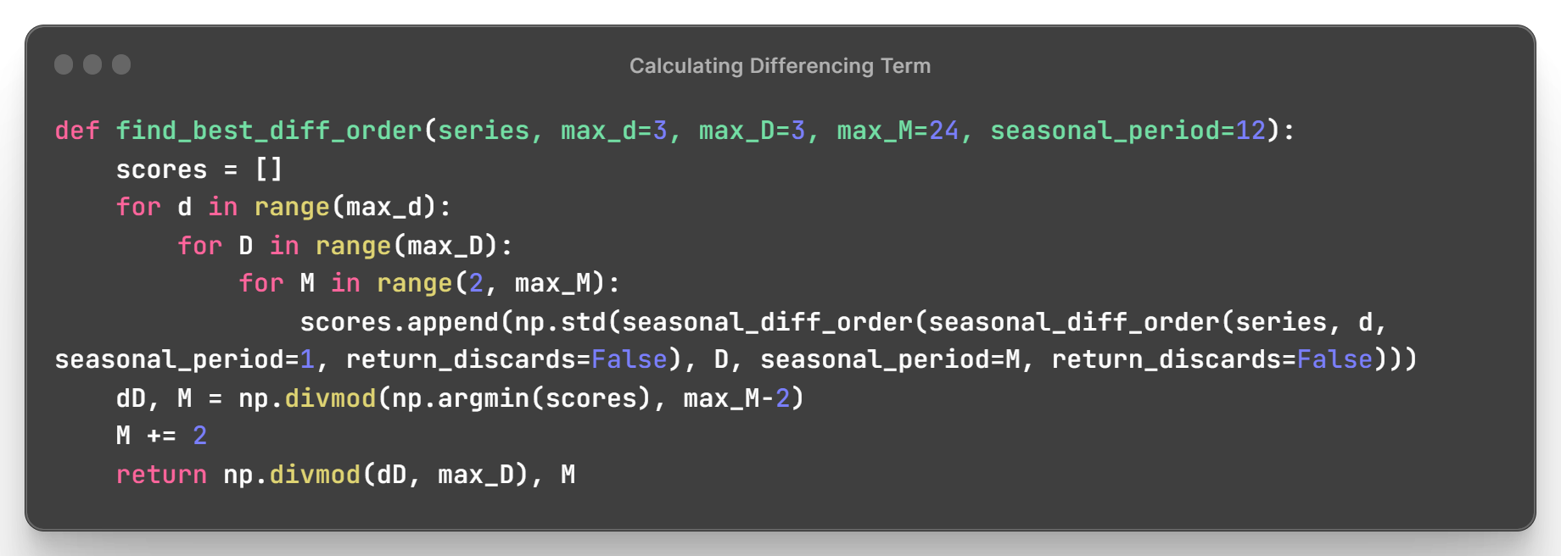
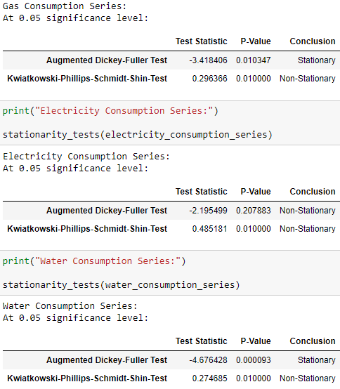

Data Exploration: Stationarity and Differencing
Gas Consumption and Water Consumption: Difference Stationary, differencing is needed to make the data strictly stationary
Electricity Consumption : Non-Stationary
I find the appropriate differencing term by iterating through a range of normal differencing and seasonal differencing orders and calculating the standard deviation for each. Then using the order with the lowest standard deviation.

Slide 5
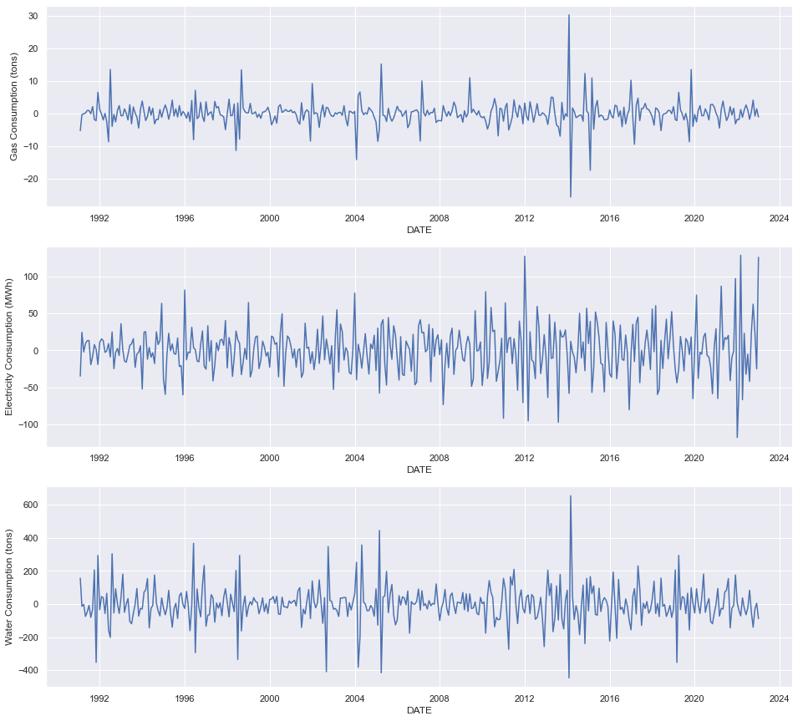
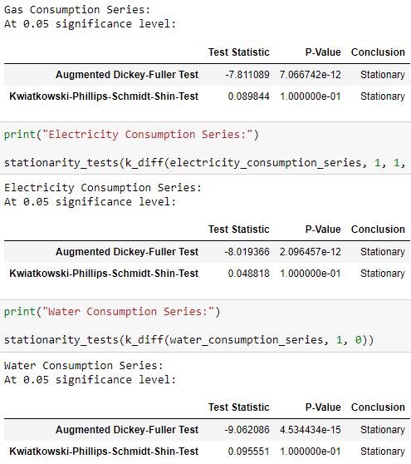
Data Exploration: Stationarity and Differencing

Slide 6
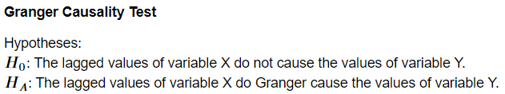
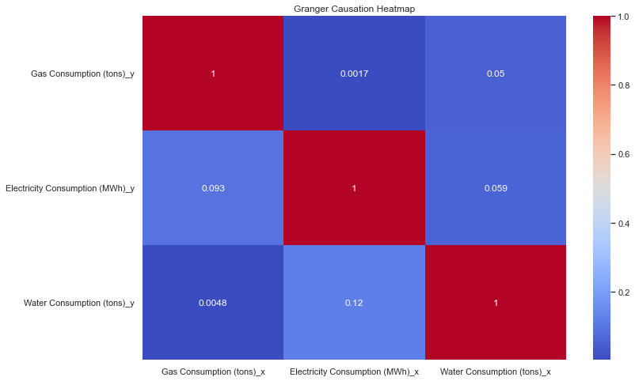
Data Exploration: Granger Causality Test
Based on a 0.05 significance level, we can conclude that Gas Consumption causes Water Consumption and Electricity Consumption causes Gas Consumption.

Slide 7
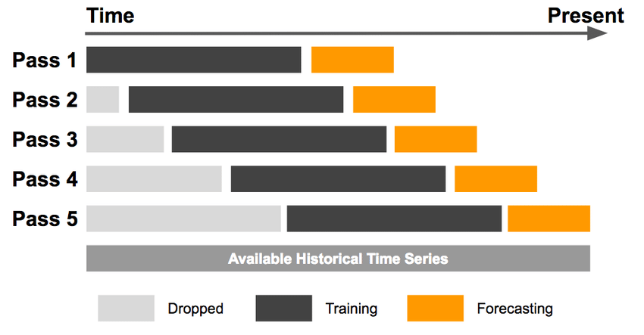
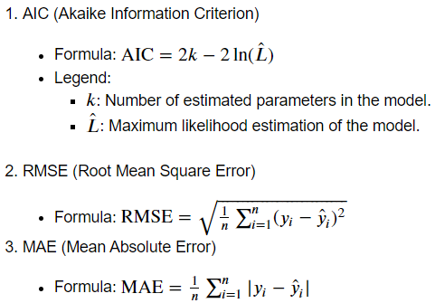
Model Selection
Scoring Metrics:
Since the goal of the prediction task is to maximize accuracy for training and testing data, RMSE and MAE are my main focus. AIC does not capture prediction accuracy.
I found that some models and parameters produced a low AIC but scored worse in terms of RMSE and MAE compared to other models.
Rolling Walk-Forward Validation

Slide 8
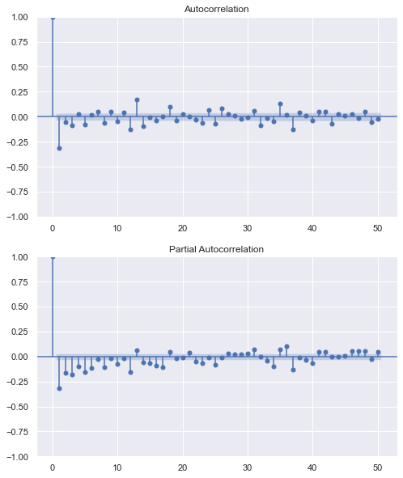
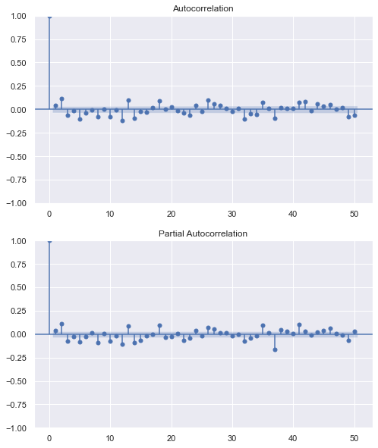

Model Selection: Determining ARMA Terms
Gas Consumption ARIMA(0, 1, 1)
Cutoff at lag-1 in ACF plot: add MA term

Slide 9
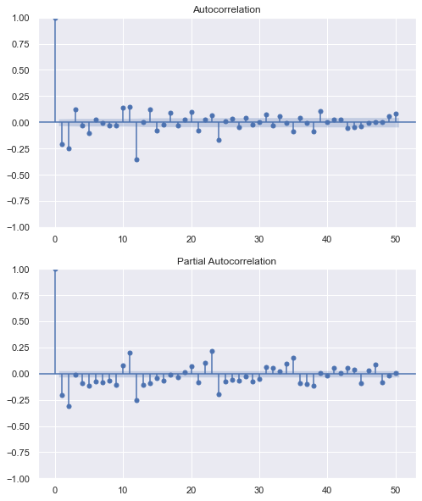
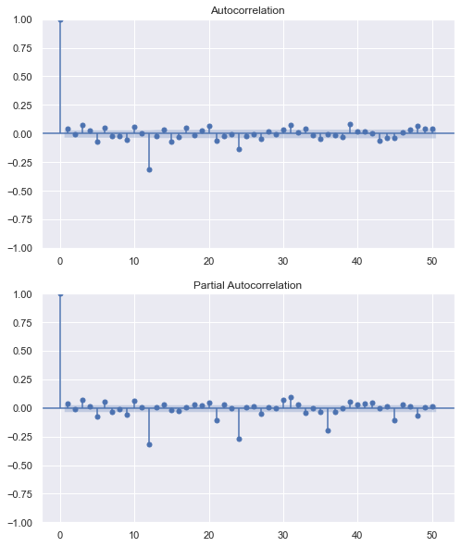

Model Selection: Determining ARMA Terms
Electricity Consumption ARIMA(1, 1, 1)
Cutoff at lag-2 in both ACF and PACF plot: add AR and MA terms

Slide 10
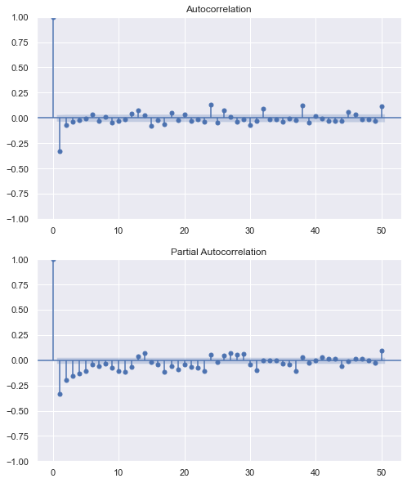
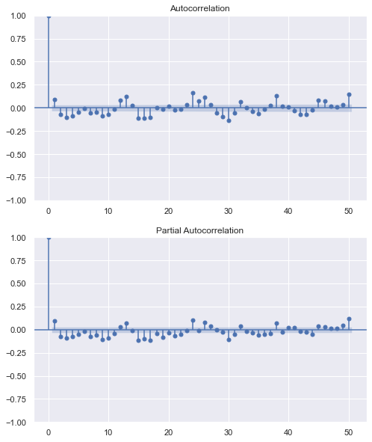
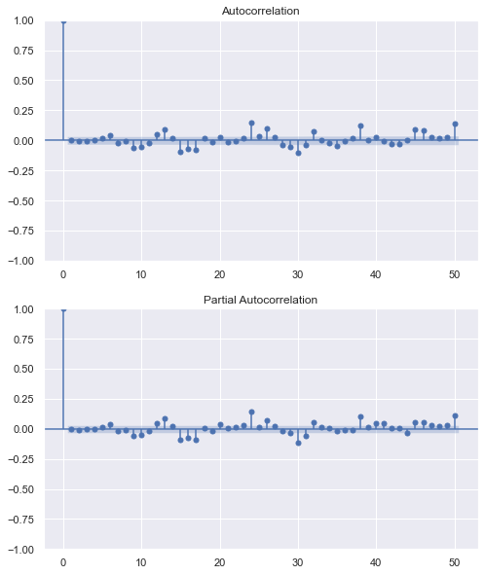

Model Selection: Determining ARMA Terms
Water Consumption ARIMA(1, 1, 2)
Cutoff at lag-1 in ACF: add MA term
Cutoff at lag-1 in both ACF and PACF plot: add AR and MA terms

Slide 11
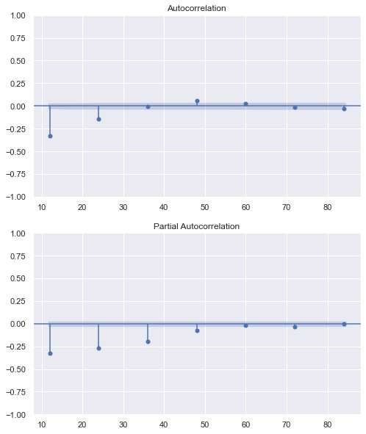
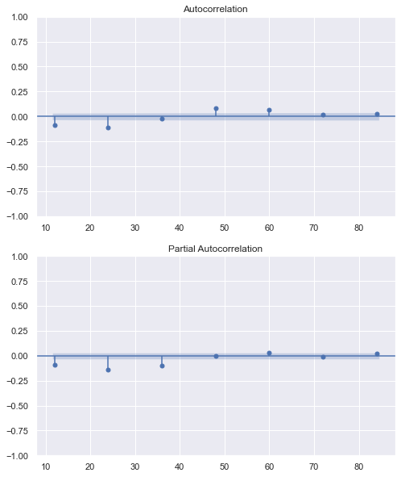
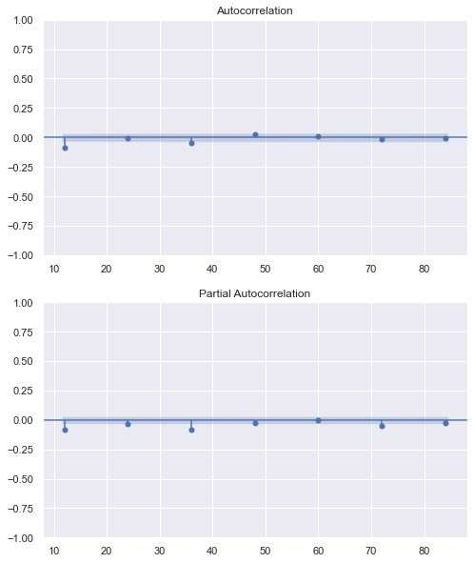

Model Selection: Determining SARMA Terms
Electricity Consumption SARIMA(1, 1, 1) x (0, 1, 4, 12)
Cutoff at lag-2 in ACF: add SMA term
Cutoff at lag-2 in ACF plot: add more SMA terms

Slide 12
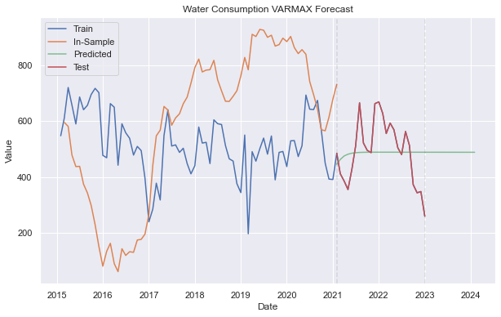
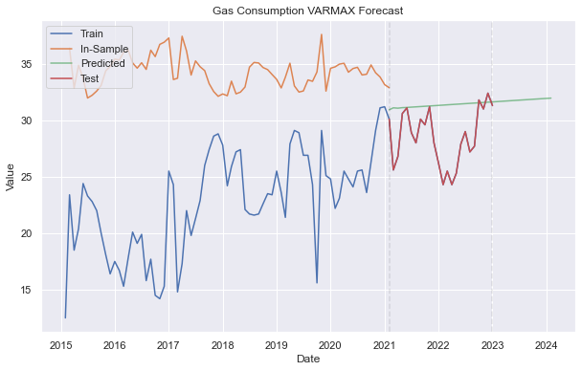


Model Selection: VARMA
Water & Gas Consumption VARMA(2, 1)
Gas & Electricity Consumption VARMA(1, 2)
Even though it produces a low test RMSE & MAE, the training RMSE & MAE is very high
Backed up by the graph

Slide 13
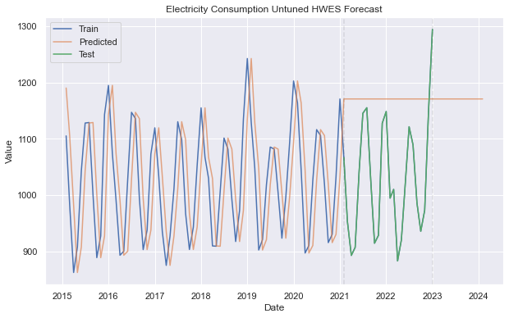

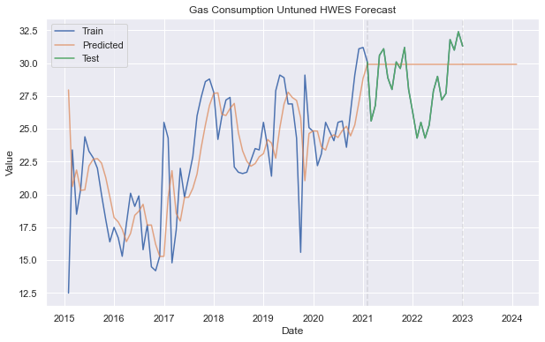
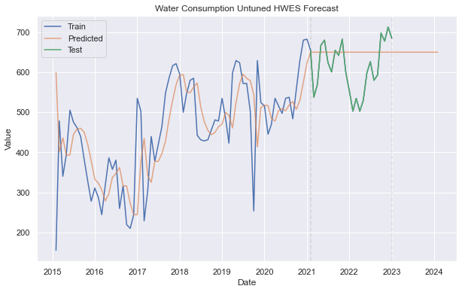


Model Selection: Holt-Winter’s Exponential Smoothing

Slide 14
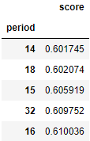

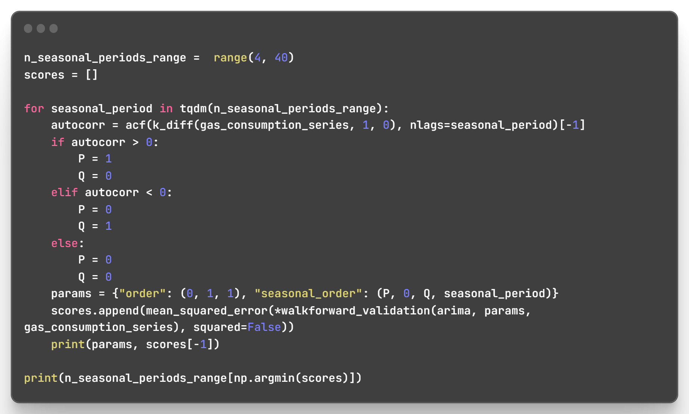
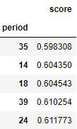

Model Improvement: Seasonality
For Gas and Water which do not have an obvious seasonal period, I will iterate through a range of possible seasonal periods to determine which seasonal period produces the optimal forecast accuracy based on RMSE.
For the SAR or SMA terms, I will follow this rule:
If the autocorrelation of the appropriately differenced series is positive at lag s, where s is the number of periods in a season, then consider adding an SAR term to the model. If the autocorrelation of the differenced series is negative at lag s, consider adding an SMA term to the model. From this article.
Gas SARIMA(0, 1, 1) x (0, 0, 1, 14)
Water SARIMA(1, 1, 2) x (0, 0, 1, 35)

Slide 15


Model Improvement: Auto ARIMA
Auto ARIMA is a tuning function that finds the optimal combination of p, d, q, P, D, and Q based on the AIC score
It can be useful to compare its results to our results but since it uses AIC, I still have to compare using RMSE and MAE
Original: Gas SARIMA(0, 1, 1) x (0, 0, 1, 14)
Original: Water SARIMA(1, 1, 2) x (0, 0, 1, 35)
Auto ARIMA: Gas SARIMA(1, 1, 1) x (1, 0, 0, 14)
Auto ARIMA: Water SARIMA(1, 1, 2) x (2, 0, 0, 12)
Auto ARIMA gave the same order as before for Electricity consumption.

Slide 16



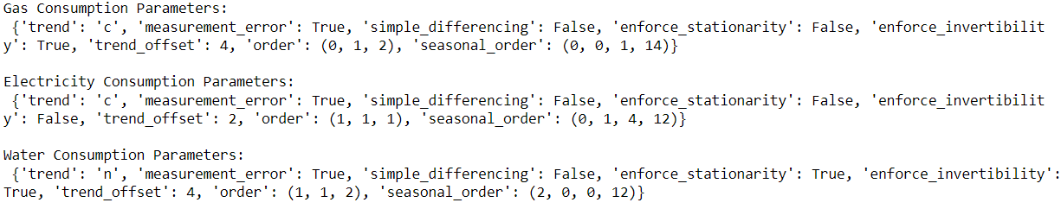
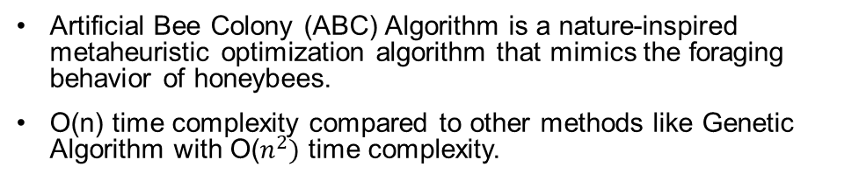
Model Improvement: Hyperparameter Tuning
Artificial Bee Colony (ABC) Algorithm is a nature-inspired metaheuristic optimization algorithm that mimics the foraging behavior of honeybees.
O(n) time complexity compared to other methods like Genetic Algorithm with O($n^{2})$ time complexity.
Original: Gas SARIMA(0, 1, 1) x (0, 0, 1, 14)
Auto ARIMA: Water SARIMA(1, 1, 2) x (2, 0, 0, 12)
Original: Electricity SARIMA(1, 1, 1) x (0, 1, 4, 12)
ABC: Gas SARIMA(0, 1, 2) x (0, 0, 1, 14)
ABC: Water SARIMA(1, 1, 2) x (2, 0, 0, 12)
ABC: Electricity SARIMA(1, 1, 1) x (0, 1, 4, 12)

Slide 17
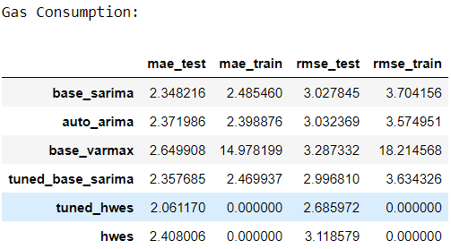
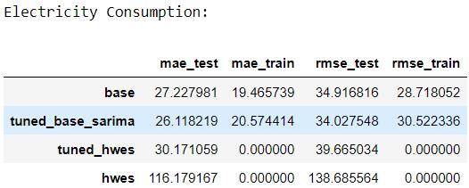
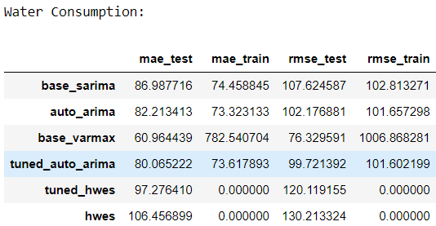
Conclusion
Tuned HWES performed the best for Gas Consumption
Tuned SARIMA performed the best for Electricity Consumption
Even though VARMAX performed the best in terms of RMSE and MAE for Water Consumption, the very bad training score as well as irregular plot makes me reject it in favour of SARIMA

Slide 18
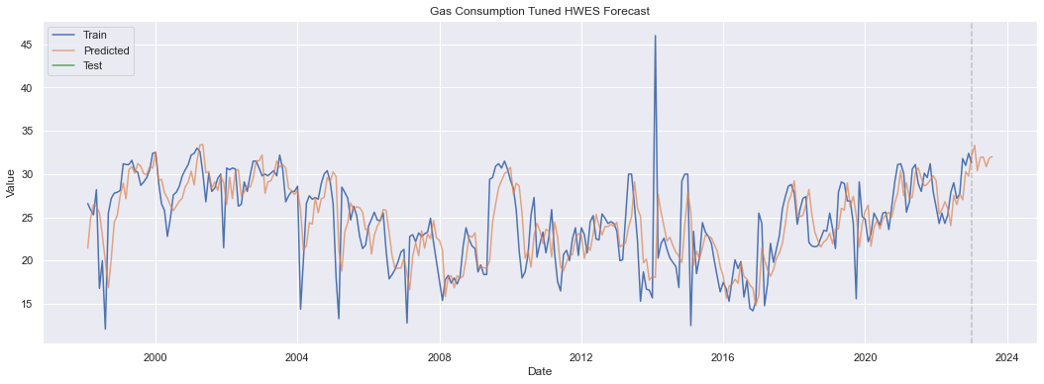
Conclusion: Gas Consumption

Slide 19
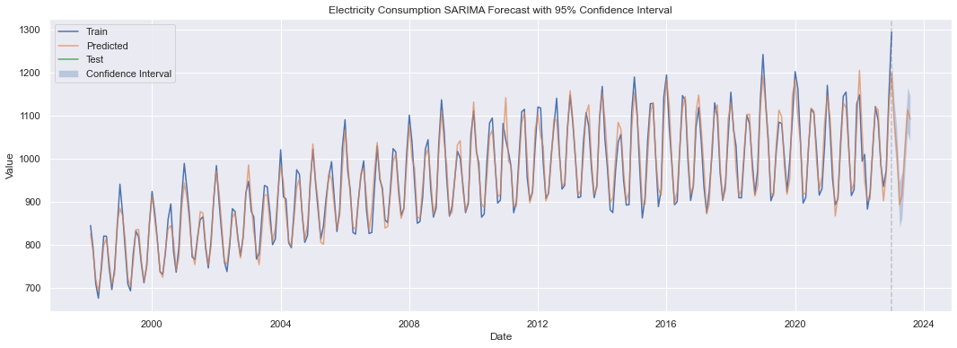
Conclusion: Electricity Consumption

Slide 20
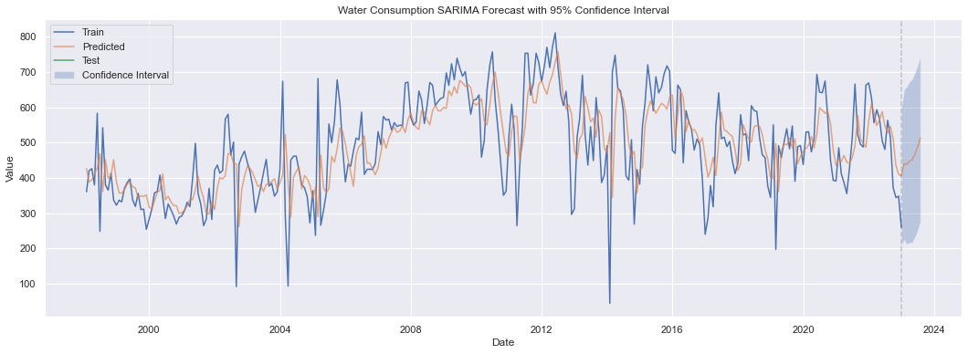
Conclusion: Water Consumption

Slide 21
AIML CA2: Part B Clustering
Name: Glenn Wu
Admin No.: 2214395
Class: DAAA/FT/2A/01

Slide 22
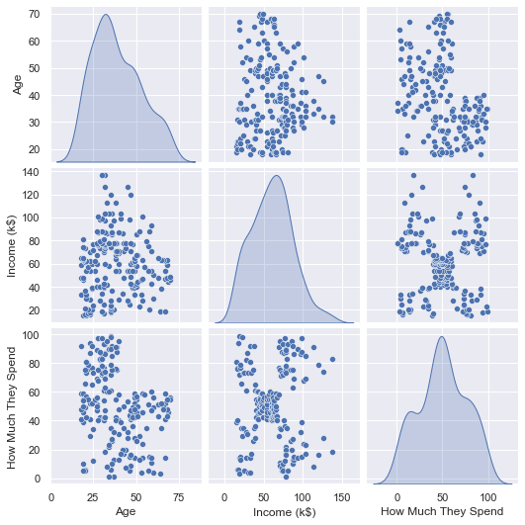
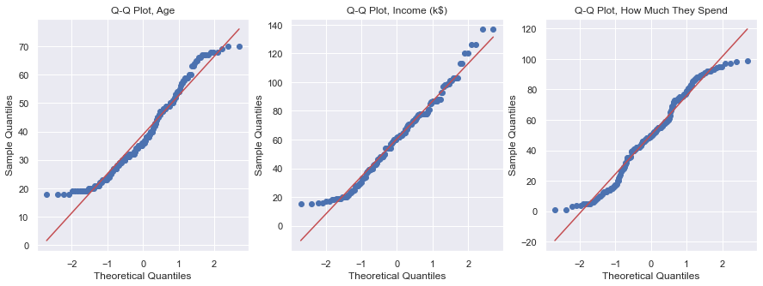
Data Exploration
None of the features follow a gaussian distribution. I will not use Gaussian Mixture Model since that is on of the underlying assumptions.

Slide 23
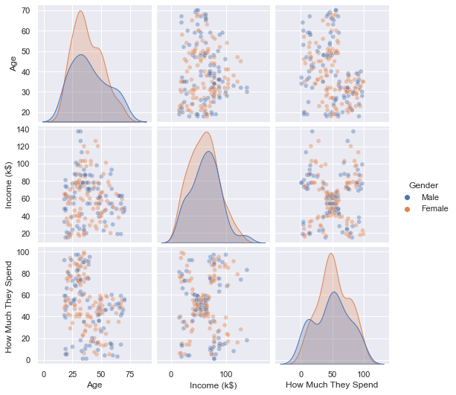
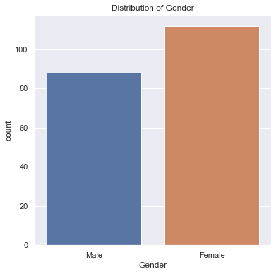
Data Exploration

Slide 24
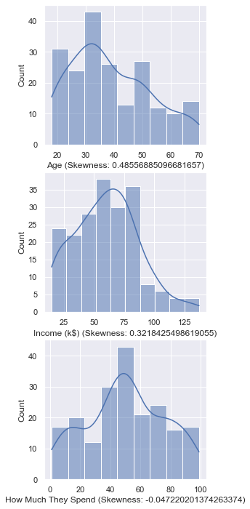
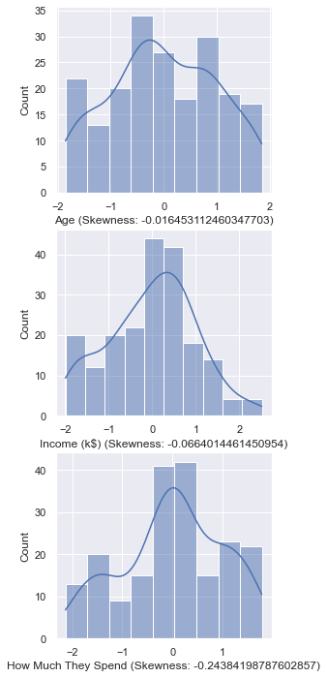
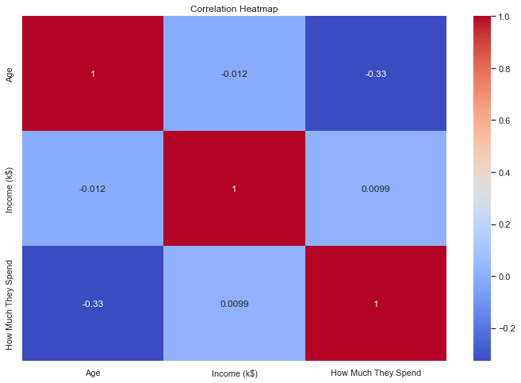
Data Exploration
Yeo-Johnson Transformation
Perform this transformation on Age and Income to lower skew
Skew Increased on “How Much They Spend”, only use standaridization.

Slide 25
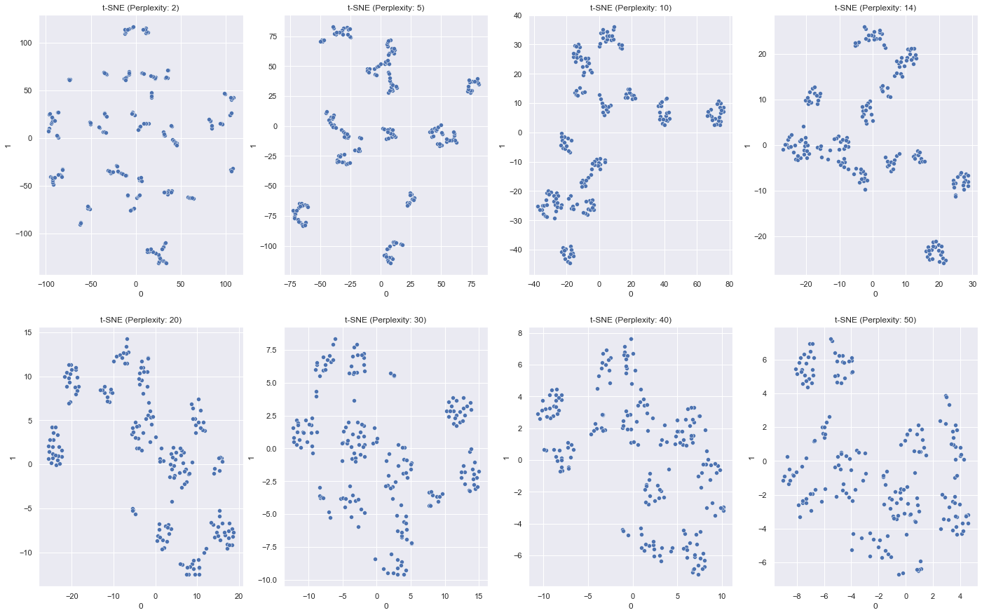
Data Exploration: t-SNE
The perplexity hyperparameter helps to control how many nearest neighbours each point considers.
It is useful to consider the t-SNE plot at different perplexity values since there is a tradeoff between preserving local and global structures.
In this case I will consider perplexities of 20 and 30.

Slide 26
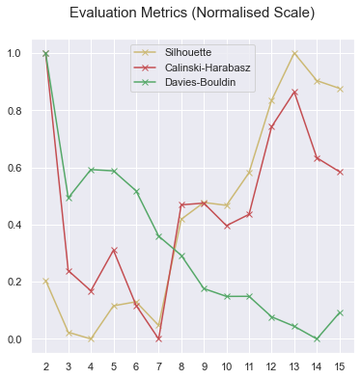
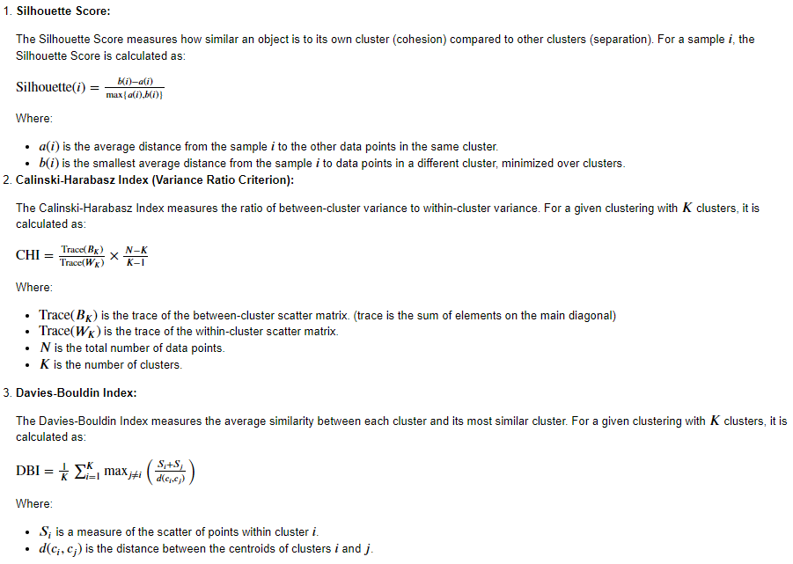
Model Selection
The metrics are all different methods to measure the quality of the clusters and do not always agree with each other.
The optimal number of clusters and the best model can be chosen using these metrics.

Slide 27
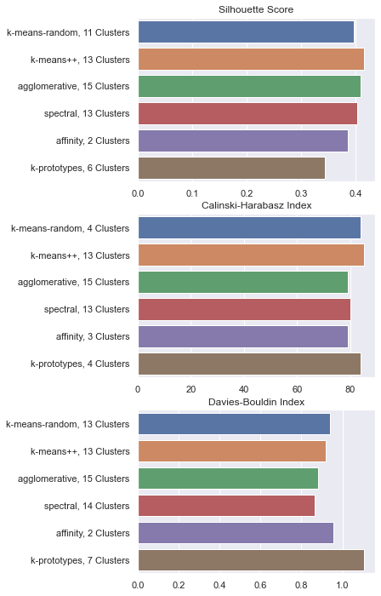

Model Selection
K-means with k-means++ initialisation seems to perform the best for all metrics at 13 clusters followed by Agglomerative Clustering and K-Prototypes.

Slide 28

Model Improvement: PCA
Only PC 5 explains less than 10% of total variance (Kaiser's Rule)
To obtain more than 80% cumulative explained variance, we have to select 3 PCs
The main weights of PC4 and PC5 and on Gender_Female and Gender_Male.
One of the features from the transformed data is completely redundant, either Gender_Male or Gender_Female, since One-Hot encoding makes creates a column for each unique value in the feature. So minimally we should expect that we can discard the last Principal Component.
Using only Prinicipal Components that have a Cumulative Explained Variance of 80%, we can also discard the 4th PC as well.
Thus, I will use PC 1, 2, and 3.

Slide 29

Model Improvement: PCA
In this case I will consider perplexities of 14 and 30.

Slide 30


Model Improvement: PCA
K-means with k-means++ initialisation performs the best across all metrics at 6 clusters.
K-Means

Slide 31


Model Improvement: PCA
PCA effectively removed the Gender columns since they contributed the least to the overall explained variance.
E.g. it combined the 13 clusters from K-Means on the original data to 6 clusters in the reduced data

Slide 32


Model Improvement: Hyperparameter Tuning
The only significant improvement is for Agglomerative Clustering on PCA with a improving Silhouette score of 0.330898 to 0.447471
K-Means is still the best performing and its Silhouette score remained unchanged at 0.457448

Slide 33


Conclusion: Cluster Interpretations (K-Means)
Cluster 0: "Young Spenders"
Demographic: Young (Average Age: 25.25), Low to Moderate Income (25.83 k$), High Spending (76.92)
Interpretation: This cluster represents young individuals with relatively lower income who spend a significant portion of their income. They might be early in their careers or education and prioritize spending on various products.
Cluster 1: "Economical Shoppers"
Demographic: Young (Average Age: 24.11), Moderate Income (58.60 k$), Moderate Spending (44.43)
Interpretation: This cluster consists of individuals who are relatively young and have moderate income. While they do spend, they tend to be more cautious and economical in their spending habits.

Slide 34
Conclusion: Cluster Interpretations (K-Means)
Cluster 4: "High-Income Savers"
Demographic: Mid-Age (Average Age: 44.00), High Income (90.13 k$), Low Spending (17.93)
Interpretation: This cluster consists of mid-age individuals, moreso males, with high incomes but relatively low spending patterns. They might be more conservative in their spending and focus on savings or specific investments.
Cluster 5: "Frugal Shoppers"
Demographic: Mid-Age (Average Age: 45.40), Low Income (25.65 k$), Very Low Spending (18.55)
Interpretation: This cluster represents individuals, especially females, with mid-age and relatively lower incomes. They exhibit frugal spending habits and are careful with their purchases.
Cluster 2: "Mid-Age Budgeters"
Demographic: Mid-Age (Average Age: 54.17), Moderate Income (54.79 k$), Moderate Spending (48.60)
Interpretation: This cluster includes individuals in their mid-age years who have moderate income and spending patterns. They may have established financial responsibilities and make reasonable but not excessive purchases.
Cluster 3: "Affluent Shoppers"
Demographic: Young (Average Age: 32.69), High Income (86.54 k$), Very High Spending (82.13)
Interpretation: This cluster represents affluent individuals, both young and mid-age, who have high incomes and consequently high spending patterns. They likely prioritize quality and luxury in their purchases.

Slide 35

Conclusion: Cluster Interpretations (Agglomerative)
The same 6 clusters from K-Means are featured with nearly identical demographics but with an additional 2 clusters.
Cluster 4: "Young Frugal Shoppers“
Demographic: Very Young (Average Age: 19.50), Very Low Income (15.50 k$), Low Spending (22.50) Interpretation: This cluster consists primarily of very young individuals, mostly males, with very low income and relatively conservative spending patterns. They exhibit frugal behaviors, likely due to financial constraints or early financial independence.
Cluster 7: "Outlier Spenders“
Demographic: Primarily Males, Very Young (Average Age: 20.75), High Income (76.25 k$), Very High Spending (8.00) Interpretation: This cluster consists exclusively of very young males with high income and extremely high spending patterns. They appear to be outliers with exceptional spending behaviors that deviate significantly from the rest of the groups.

